Slide 1
Experience in michelin restaurant

Slide 4
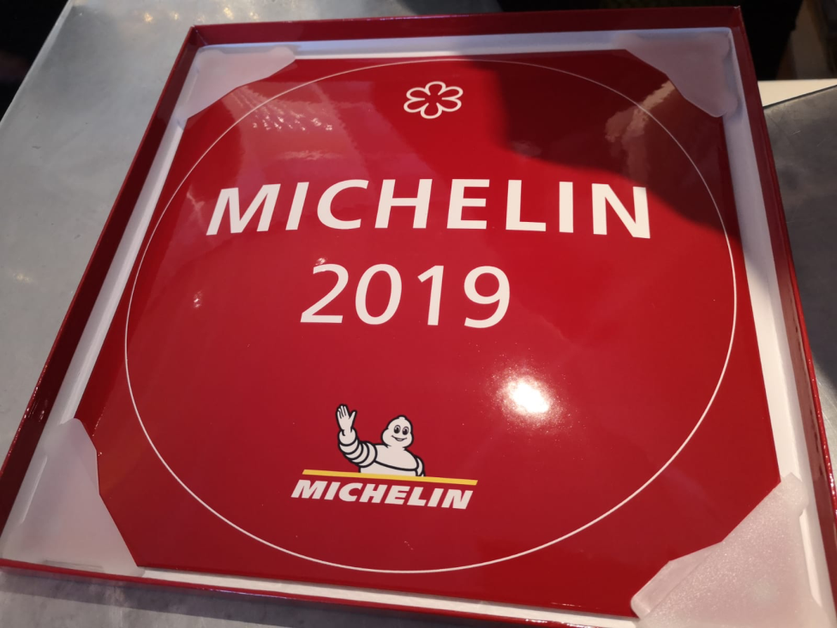
On the 4th of April we were playing a game called moki and 5 of us cooks were competing to win a visit to a Michelin star restaurant. Matic won and I Nika was second best. We had the privilege to go in their kitchen and taste everything on their menu.

Slide 5
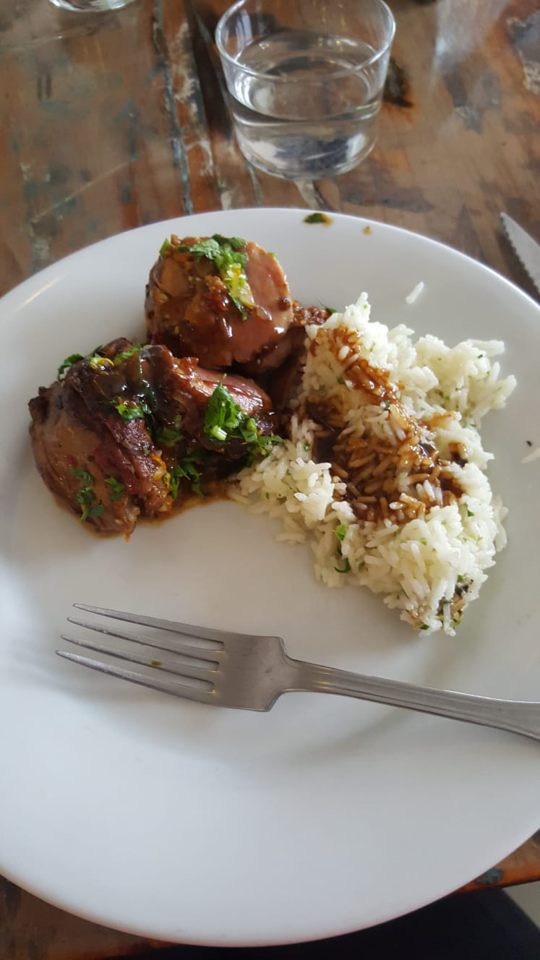
When we arrived we ate dinner with the staff. They introduced theirselves, offered us coffee and invited us into the kitchen.

Slide 6
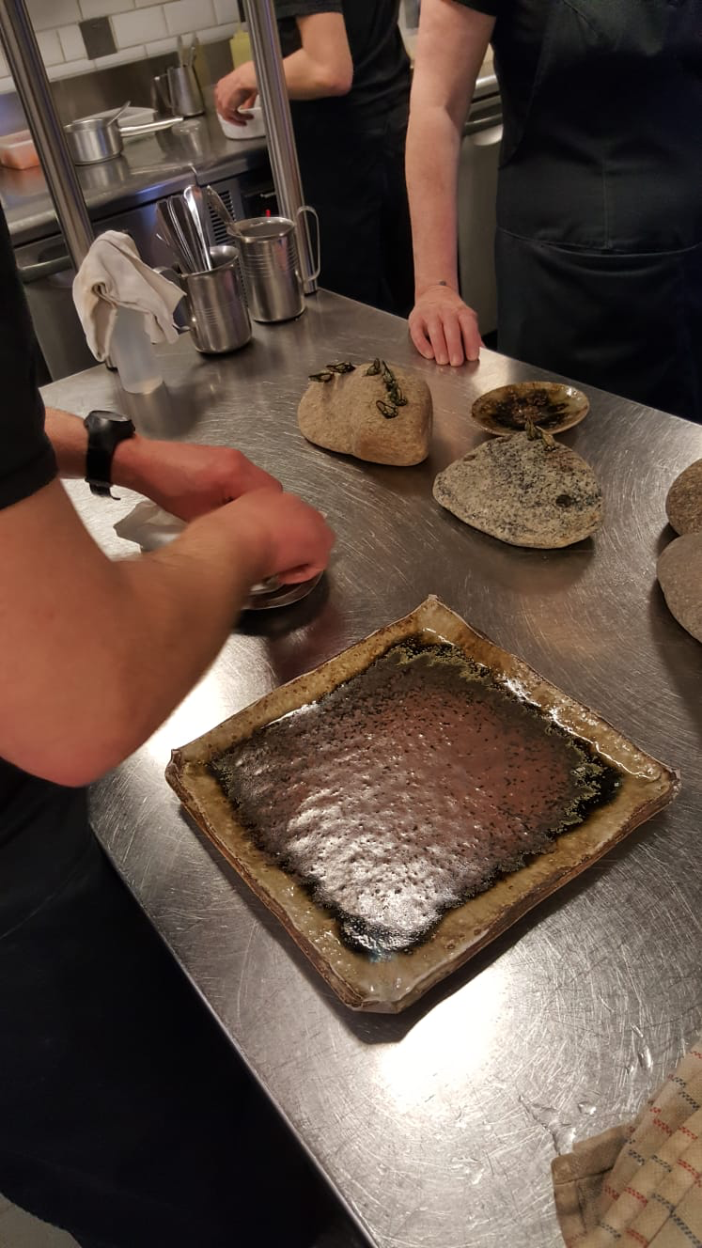

Slide 7
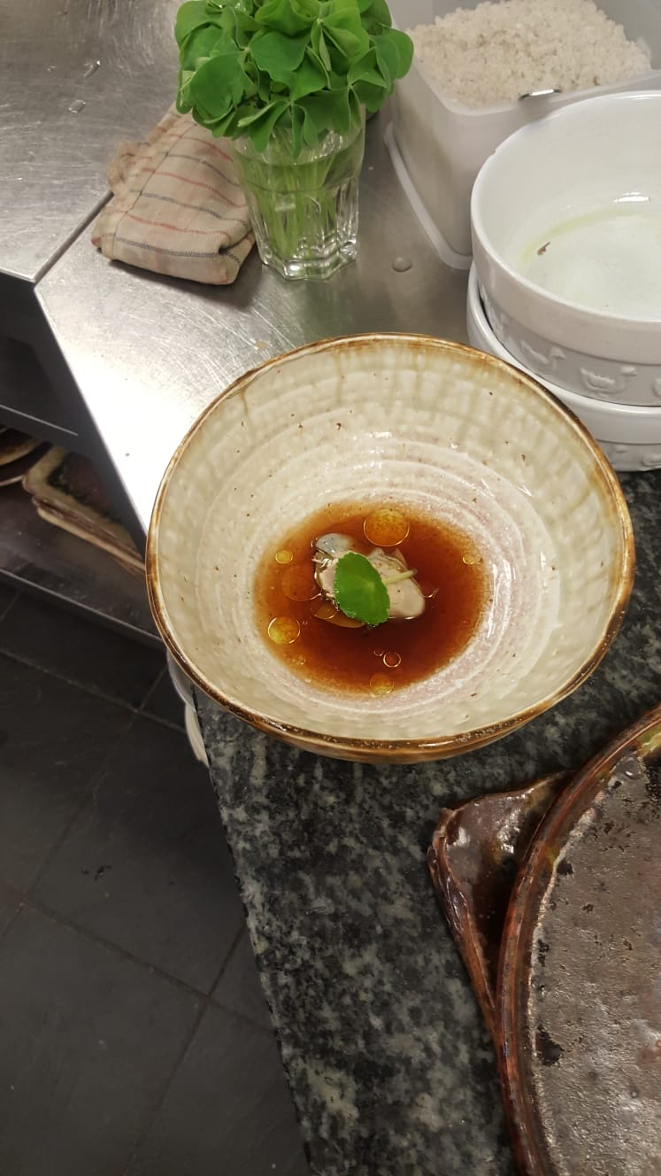

Slide 9
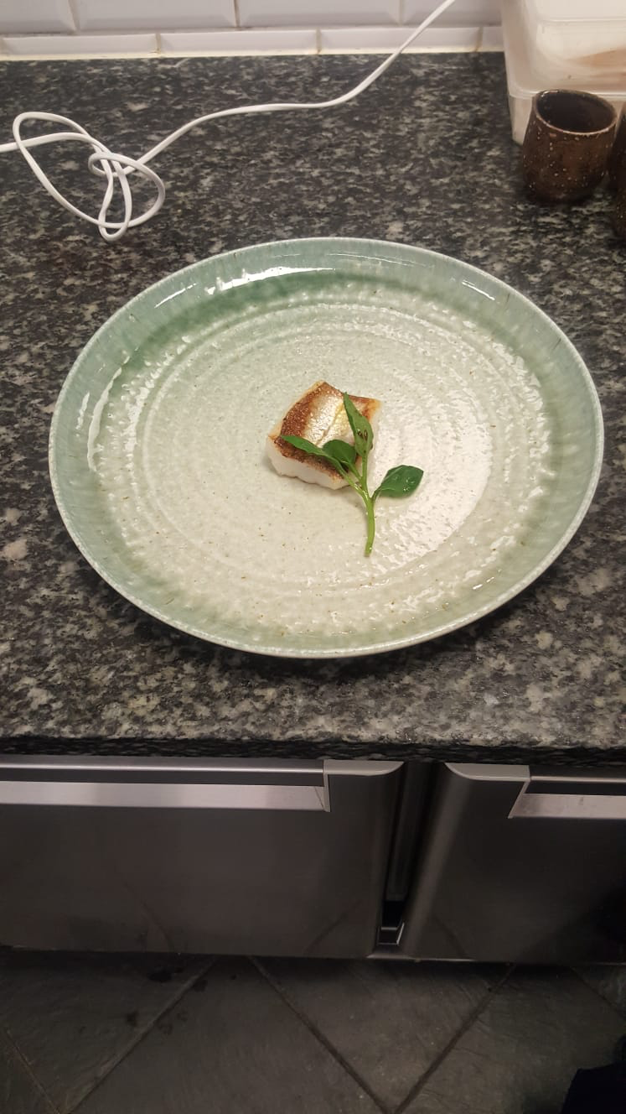

Slide 10
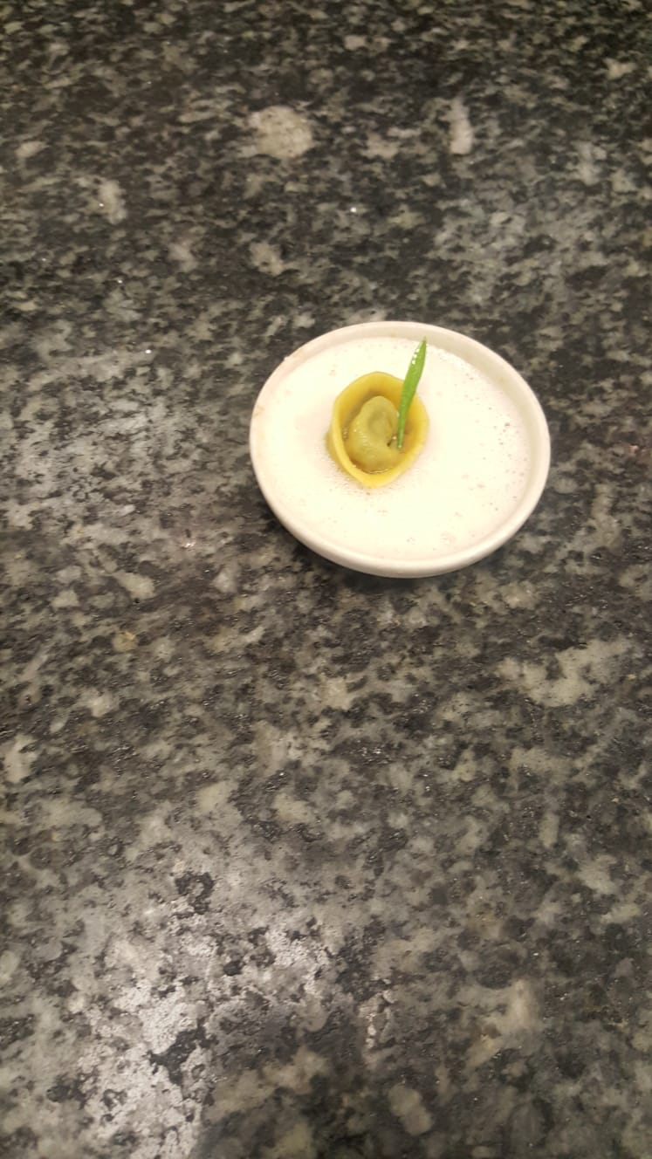

Slide 11
